Slide 1
CLOCKS-CONCEPT & PROBLEM SOLVING

Slide 2
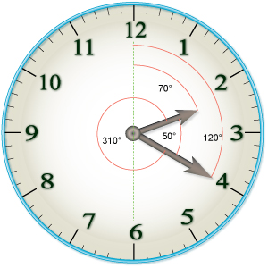
Speed of Minute hand = 6º / minute
*Minute hand covers 360 degrees in 60 minutes
Speed of hour hand = 0.5º /minute
Hour hand covers 30 degrees in 60 minutes
To Calculate angle between minute and hour hand
Degree(θ) = 11/2 (M) – 30º (H)
or
Degree(θ) = 30º (H) – 11/2 (M)
Where,
M -→ minutes
H → hours

Slide 3
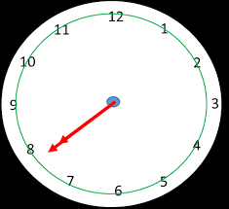
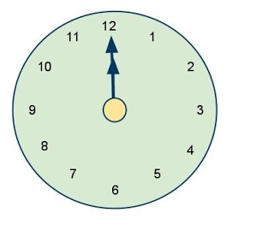

Coincidence of hands in clock- [ 0⁰ or 360⁰]
The hour hand and minutes hand coincides every 65 $\frac{5}{11}$minutes
12:00, 1.05 $\frac{5}{11}$ , 2.10 $\frac{10}{11}$ , 3.15 $\frac{15}{11}$, . . . . . . . . . . . . . . , 10.50$\frac{50}{11}$
The hands of the clock coincides 11 times in 12 hours , 22 times in 24 hours.

Slide 4

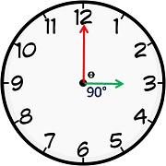
1⁰ to 359º – It occurs 22 times in 12 hours and 44 times in 24 hours

Slide 5
1. How many degrees does an hour hand move in 54 minutes?
A. 304 B. 108 C. 27 D. 54
54 * 0.5 = 27
2. How many degrees does the minute hand move in the same time in which an hour hand moves by 18 degree?
A. 108 B. 9 C. 256 D. 216
To move 18 degree hour hand will take 36 minutes
In that 36 minutes minute hand will cover 36*6 = 216 degree.
3. If a clock is kept on the table in such a way that at 3:10 pm the hour hand points south, after how much time will the minute hand
point east?
A. 20 minutes B. 35 minutes C. 50 minutes D. 90 minutes
If hour hand points south which means 3 – south , 9 will be north, 12 will be east, 6 will be west
To move from 2 to 12 minute hand will take 50 minutes.

Slide 6
4. The mirror reflection of a clock shows 3.30 hrs. After two hours, what time the mirror
reflection of the clock will show?
8.30 B. 5.30 C. 2.30 D. 1.30
Mirror reflection means left will become right and right will become left . So 3.30 is the mirror image means correct time will be 8.30 . After 2 hours 10:30 corresponding mirror image will be 1:30
5. There is a clock hanging on the wall. The reflection of the clock in a mirror shows exactly the same time as the clock. How many times does this happen in 6 days?
11 B. 12 C. 22 D. 24
Mirror image & actual time will be same at 12:00 & 6:00 . In a day 12 will occur twice and 6 will occur twice. Total 4 times in a day. So in 6 hours it will be 24 times.
6. What is the reflex angle when the time is 1:30?
225 B. 135 C. 150 D. 175
Degree(x) = 11/2 (30) – 30(1) = 165 – 30 = 135
Reflex angle = 360-135 = 225
7. An accurate clock shows 8 O’clock in the morning. Through how many degrees will the hour hand rotate when the clock shows 2 O’clock in the afternoon?
180 B. 150 C. 120 D. 270
6 * 30 = 180
8. What is the angle between the two hands of a clock when time is 20 minutes past 5?
0 B. 40 C. 30 D. 15
B – 40 (using the formula)

Slide 7
9. At what time between 8 p.m. and 9 p.m. will the minute hand coincide with the hour hand?
43 7/11 past 8 B. 47 7/11 past 8 C. 40 past 8 D. 42 7/11 past 8
0 = 11/2(M) – 30(8)
240 = 11/2 (M)
M = 480/11
43 7/11 past 8
10. At what time between 5 O’clock and 6 O’clock will the hands of a watch be at right angles?
10 10 /11 past 5 B. 43 7/11 past 5 C. Both A & B D. None of these
90 = 11/2(M) – 30(5) 240 = 11/2 (M) M = 480/11 43 7/11 past 5
90 = 30(5) – 11/2(M) 60 = 11/2 (M) M = 120/11 10 10 /11 past 5
Answer: Both A & B
11. Find the time between 3 and 4 O’clock at which the minute hand and the hour hand make an angle 60 with each other.
5 5/11 past 3 B. 27 3/11 past 3 C. Both A & B D. None of these

Slide 8
12. A mechanical grandfather clock is at present showing 7 hrs 40 min 6 sec. Assuming
that it loses 4 sec in every hour, what time will it show after exactly 6 1/2 hours?
A. 2 hr 9 min 40 sec B. 2 hr 10 min 6 sec C. 14 hr 9 min 34 sec
D. 14 hr 10 min 32 sec

Slide 9
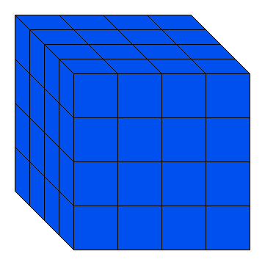
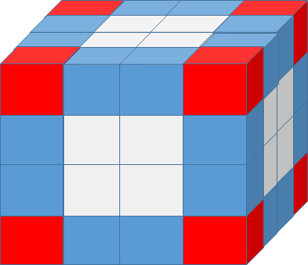
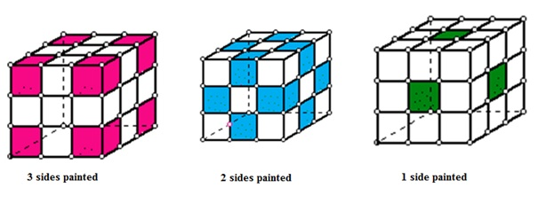
8- corners 6- faces 12- edges
Cubes
3 faces painted- corners (8) 2 faces painted- 12(n-2) 1 face painted- 6(n-2)²
0 faces painted - (n-2)³
n- inch/cm

Slide 10
Cubes
A cube of each side 4 cm has been painted black, red and green on pairs of opposite faces. It is then cut into small cubes of each side 1 cm. Then find
1. How many small cubes will be there?
2. How many small cube will have three faces painted?
3. How many small cubes will have no faces painted?
4. How many small cubes will have only one faces painted?
5. How many small cubes will have only two faces painted?
6. How many small cubes will have only two faces painted black and green and all other faces unpainted?
7. How many small cubes will have only two faces painted green and red?
8. How many small cubes will be only black painted?
9. How many small cubes will have at least two faces painted?
10. How many small cubes will have at least one face painted?

Slide 11
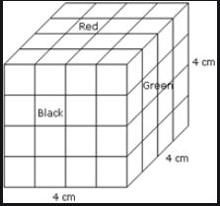
4*4*4 = 64
8 – corners
(n-2)^3 = (4-2)^3 = 2^3 = 8
6(n-2)^2 = 6*4 = 24
12(n-2) = 12*2 = 24
8 (refer image)
8 (refer image)
8 (refer image)
atleast 2 faces painted
so 2 faces painted + 3 faces painted
= 24+8 = 32
10. Total cubes – 0 faces painted
64 – 8 = 56

Slide 12
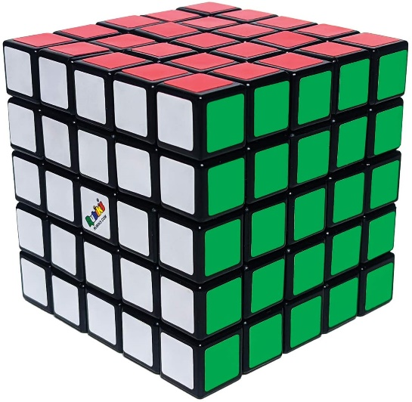
A cube is painted in such a way that a pair of adjacent faces is painted in green; a pair of opposite faces is painted in white and another pair of adjacent faces is painted in red. This cube is now cut into 125 small but identical cubes.
11. How many of the small cubes do not have green colour but have white or red colours on them?
A. 40 B. 75 C. 80 D. 53
12. How many small cubes have exactly two painted face and have exactly two colours on them?
A. 36 B. 30 C. 24 D. 34

